Slide 1


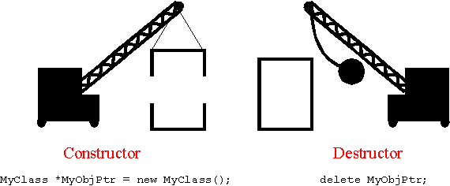
CONSTRUCTORS
AND
DESTRUCTORS

Slide 2
Contents
▪
▪
▪
▪
▪
Constructors
Types of Constructors
Constructor Overloading
Default arguments
Destructor
to Constructor
2

Slide 3
Constructor
▪
Constructors are the special type of member
function that initializes the object automatically
when it is created.
The Compiler calls the Constructor whenever an object is created.
Constructors initialize values to object members after storage is allocated to the object.
They are having the same name as a class name.
They do not have any return type.
▪
▪
▪
▪
3

Slide 4







Types
of
constructors
Constructor
Default
Parameterized
Copy
4

Slide 5
Default
constructor
▪
A default constructor is a constructor which can
be called with no arguments.
If no user-declared constructors in program, the compiler will always declare a default constructor as an inline public member of its class.
▪
▪
Syntax:
class_name () { Constructor Definition }
5

Slide 6
Parameterized
Constructor
▪
▪
These are the constructors with parameter.
Using this Constructor you can provide different values to data members of different
objects, by
argument.
passing
the
appropriate
values
as
6

Slide 7
Copy
constructor
▪
These are special type of Constructors which
takes an object as argument, and is used to
copy values of data
members
of
one
object
into
other
object.
7

Slide 8
Dynamic
Constructor
▪
Dynamic constructor is used to allocate the
memory to the objects at the run time.
Memory is allocated at run time with the help
of 'new' operator.
▪
▪
By using
initialize
this constructor,
we
can
dynamically
the
objects.
8

Slide 9
Constructor Overloading
▪
Constructors can also be overloaded. Infect
when you have both default and
parameterized constructors defined in your
class you are having Overloaded
Constructors, one with no parameter and
other with parameter.
▪
You can have any number of Constructors
class that differ in parameter list.
in
a
9

Slide 10
Program
on
the
concept
of
constructor
#include <iostream>
operations(operations &p) //Copy Constructor
{
a=p.a;
b=p.b;
}
using namespace std;
class operations
{
int *c;
int a,b,mul,div,sum,sub;
public:
operations(int q)
{
c=new int;
//Dynamic Construcotr
operations()
{
a=10;
b=20;
}
//Default Constructor
*c=q;
}
operations(int x,int y) //Parameterized Constructor
{
a=x;
b=y;
}
10

Slide 11
void display()
{
cout<<"Value of a variable is"<<*c<<endl;
}
int main()
{
cout << "\t\t1.Calling Default Constructor" <<
endl;
operations op1;
op1.add();
cout << "\t\t2.Calling Perameterized
Constructor" << endl; operations op2(100,50); op2.subt();
cout << "\t\t3.Calling Dynamic Constructor"
<< endl;
operations op4(100);
op4.display();
cout << "\t\t4.Calling Copy Constructor" <<
endl;
operations op3=op2;
op3.mult();
void add()
{
sum=a+b;
cout<<"sum is"<<sum<<endl;
}
void subt()
{
sub=a-b;
cout<<"subtraction is"<<sub<<endl;
}
void mult()
{
mul=a*b;
cout<<"Multiphication is"<<mul<<endl;
}
return 0;
}
11

Slide 12
Destructor
▪
Destructor is a special class function which
destroys the object as soon as the scope of
object ends. The destructor is called
automatically by the compiler when
goes out of scope.
Destructor don not have argumetns Destructor can not be overloaded The syntax for destructor is same as
the object
▪
▪
▪
that for the
constructor, the class name is used for the name
of destructor, with a tilde ~ sign as prefix to it.
12

Slide 13
Properties of
Destructor
Constructors
&
▪
Constructor and destructor can not be inherited
although they can be call in derived class.
Destructor can be virtual but constructor can not be.
We can not access the address of constructor and destructor.
Constructor and destructor can make implicit call to operator new and delete if memory allocation and de-allocation is required for and object.
▪
▪
▪
13

